Slide 1

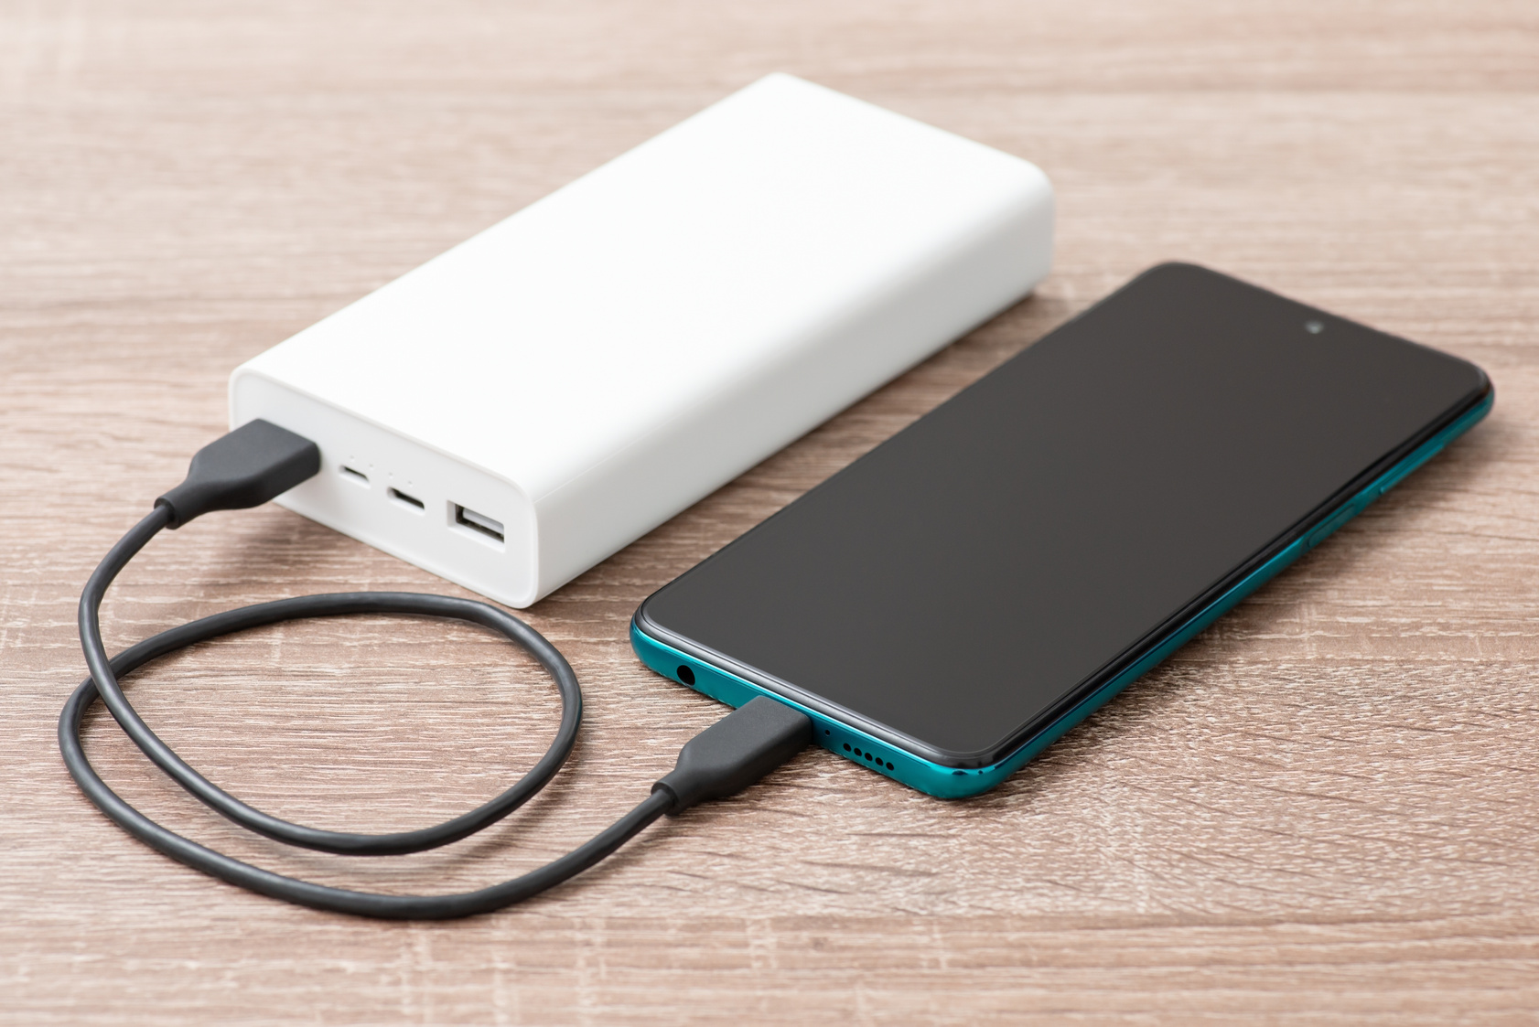

Arduino Based Charging System With
Timer Based Shutdown
CREATED BY
KOMAL RAMESH DHADKE (J40)
SANJIVANI PANDURANG SAJJAN (J41)
ARYAN SURENDRA SAKHARE (J42)
ALANKRUT VIKAS MESHRAM (J43)

Slide 2
Arduino Based Charging System With
Timer Based Shutdown
UNDER THE GUIDANCE OF
Dr. Jaishri Waghmare
Mr. Suraj D. Kulkarni
Ms. Vrashali E. Hotalkar
Mr. Rohit M. Khadkikar

Slide 3

Table of
CONTENTS
01
02
03
04
Gantt Chart
Need
Statement
Problem Statement
Pugh Chart
05
06
07
08
PCC chart
Introduction
Block Diagram
Working Principle
09
10
11
12
Schematic Diagram
Applications
Conclusion And Future Scope
References

Slide 4

GANTT
CHART
TASKS | START DATE | END DATE | DAYS TO COMPLETE
Selecting Topic | 27/03/2024 | 27/03/2024 | 01
Gathering Information | 28/03/2024 | 02/04/2024 | 06
Collecting Components | 13/04/2024 | 13/04/2024 | 01
Connecting Components | 15/04/2024 | 20/04/2024 | 06
Trial And Error | 21/04/2024 | 25/04/2024 | 05
Preparing Report and PPT | 26/04/2024 | 28/04/2024 | 03
TOTAL | TOTAL | TOTAL | 22

Slide 5
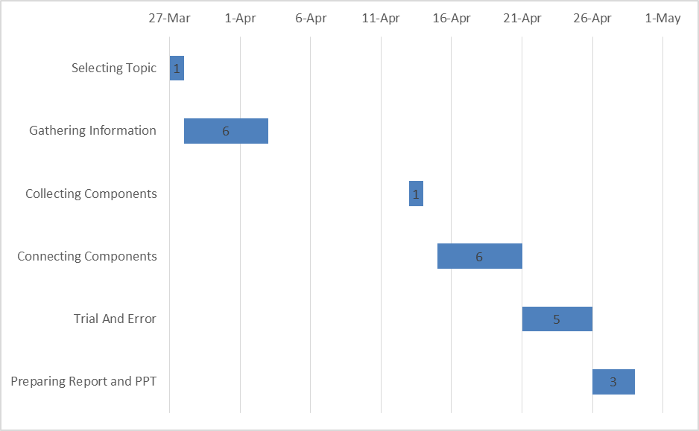
GANTT
CHART

Slide 6
NEED STATEMENT
IN A WORLD INCREASINGLY RELIANT ON ELECTRONIC DEVICES, THERE IS A GROWING DEMAND FOR EFFICIENT AND USER-FRIENDLY CHARGING SOLUTIONS THAT PRIORITIZE BATTERY LONGEVITY AND ENERGY CONSERVATION. TRADITIONAL CHARGING METHODS OFTEN LACK THE CAPABILITY TO PREVENT OVERCHARGING, LEADING TO REDUCED BATTERY LIFE AND POTENTIAL SAFETY HAZARDS. ADDITIONALLY, USERS OFTEN FACE CHALLENGES IN MANAGING CHARGING TIMES, RESULTING IN UNNECESSARY ENERGY CONSUMPTION AND INCONVENIENCE. THEREFORE, THERE IS A CRITICAL NEED FOR A CHARGING SYSTEM THAT INTEGRATES ADVANCED TECHNOLOGY TO OFFER CUSTOMIZABLE CHARGING DURATIONS WHILE ENSURING AUTOMATIC SHUTDOWN TO PREVENT OVERCHARGING AND OPTIMIZE ENERGY USAGE. SUCH A SYSTEM WOULD ADDRESS THE PRESSING CONCERNS OF BOTH DEVICE USERS AND ENVIRONMENTAL SUSTAINABILITY, ENHANCING USER EXPERIENCE AND CONTRIBUTING TO THE EFFICIENT UTILIZATION OF RESOURCES.

Slide 7
PROBLEM STATEMENT
THE PROLIFERATION OF ELECTRONIC DEVICES IN MODERN SOCIETY HAS LED TO AN INCREASED DEMAND FOR RELIABLE AND EFFICIENT CHARGING SOLUTIONS. HOWEVER, EXISTING CHARGING METHODS OFTEN LACK INTELLIGENT FEATURES TO PREVENT OVERCHARGING AND OPTIMIZE ENERGY USAGE. USERS FACE CHALLENGES IN MANAGING CHARGING TIMES, LEADING TO WASTED ENERGY AND REDUCED BATTERY LIFESPAN. FURTHERMORE, THE LACK OF CUSTOMIZABLE OPTIONS HAMPERS USER FLEXIBILITY AND CONVENIENCE. THEREFORE, THERE IS A PRESSING NEED FOR A CHARGING SYSTEM THAT INTEGRATES ADVANCED TECHNOLOGY TO OFFER USER-SET TIME-BASED CHARGING CAPABILITIES, ENSURING AUTOMATIC SHUTDOWN TO PREVENT OVERCHARGING AND PROMOTE ENERGY EFFICIENCY. ADDRESSING THIS PROBLEM WOULD NOT ONLY ENHANCE USER EXPERIENCE BUT ALSO CONTRIBUTE TO SUSTAINABLE ENERGY PRACTICES AND THE PROLONGED LIFESPAN OF ELECTRONIC DEVICES.

Slide 8
PUGH
CHART
Criteria | Weight | Standard Baseline Charging System | Arduino Based Charging System | WiFi Charging System | Wireless Charging System
User Convenience | 3 | - | D | ++ | +
Energy Efficiency | 3 | 0 | A | + | ++
Cost | 2 | + | T | -- | --
Safety | 2 | + | U | + | +
Compatibility | 1 | + | M | - | +
+ |  | +5 |  | +11 | +12
0 |  | 1 |  | 0 | 0
- |  | -3 |  | -5 | -4
Total |  | +2 |  | +6 | +8

Slide 9
PCC
CHART
 | User Convenience | Energy Efficiency | Cost | Safety | Compatibility | Total
User Convenience | - | 0 | 0 | 0 | 0 | 0
Energy Efficiency | 1 | - | 0 | 0 | 0 | 1
Cost | 1 | 1 | - | 0 | 1 | 3
Safety | 1 | 1 | 1 | - | 1 | 4
Compatibility | 1 | 0 | 1 | 0 | - | 2
RANK:-
i. Safety
ii. Cost
iii. Compatibility
iv. Energy Efficiency
v. User Convenience

Slide 10
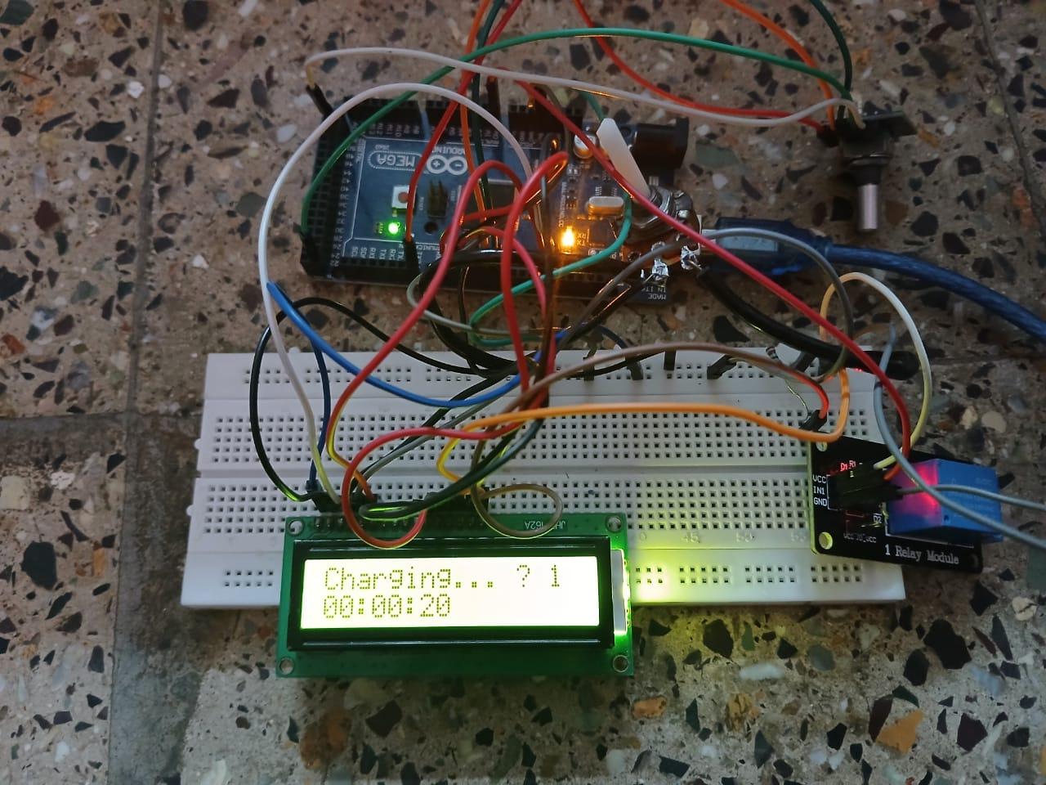
INTRODUCTION
This Project introduces an Arduino-based charging system designed to address challenges associated with energy consumption and battery management in portable electronic devices. The system incorporates a time-based shutdown feature, allowing users to set precise charging durations to prevent overcharging and optimize energy usage. Utilizing an Arduino microcontroller and relay modules, the system offers a simple user interface for customization. The design aims to enhance battery health and energy efficiency compared to traditional charging methods. Through this project, the potential for broader applications in smart charging technologies and sustainable energy practices is highlighted.

Slide 11
BLOCK
DIAGRAM
16X2 LCD DISPLAY
ROTARY ENCODER
ARDUINO MEGA 2560
5V RELAY MODULE
SINGLE SOCKET POWER OUTLET BOX

Slide 12
WORKING PRINCIPLE
THE WORKING PRINCIPLE OF THE ARDUINO-BASED CHARGING SYSTEM WITH A TIME-BASED SHUTDOWN FEATURE BEGINS WHEN THE USER SETS A DESIRED CHARGING DURATION USING A SIMPLE INTERFACE CONNECTED TO THE ARDUINO MICROCONTROLLER. UPON INITIATION, THE SYSTEM STARTS THE CHARGING PROCESS BY ACTIVATING A RELAY MODULE THAT ALLOWS POWER TO FLOW FROM THE POWER SOURCE TO THE DEVICE BEING CHARGED. THE ARDUINO CONTINUOUSLY MONITORS THE ELAPSED TIME AGAINST THE USER-SET DURATION. ONCE THE PRESET TIME IS REACHED, THE ARDUINO SENDS A COMMAND TO THE RELAY MODULE TO CUT OFF THE POWER SUPPLY, EFFECTIVELY STOPPING THE CHARGING PROCESS AND PREVENTING OVERCHARGING. THIS MECHANISM ENSURES THAT THE DEVICE IS CHARGED FOR EXACTLY THE DURATION SPECIFIED BY THE USER, PROMOTING BOTH SAFETY AND ENERGY EFFICIENCY.

Slide 13
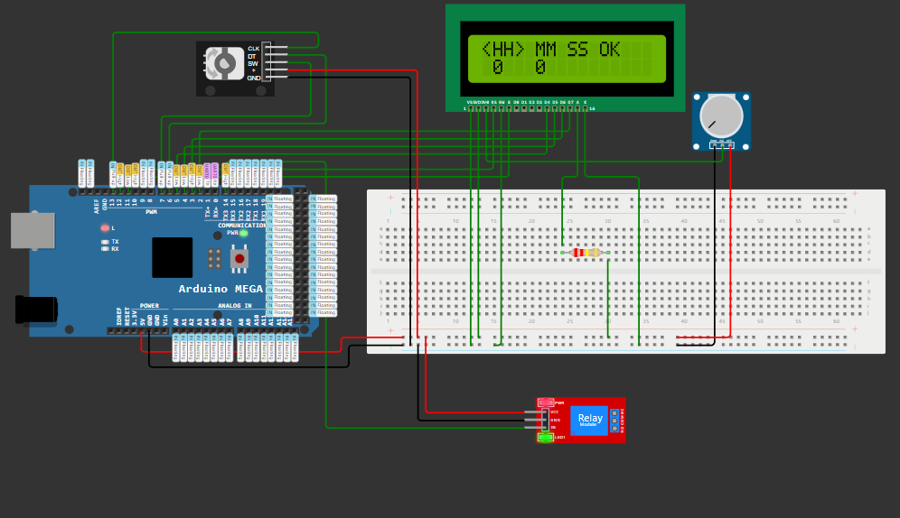
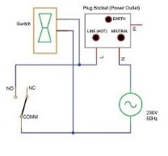
SCHEMATIC DIAGRAM

Slide 14
APPLICATIONS
(1) Consumer Electronics: Integration into smartphones, tablets, and laptops for optimized battery charging, enhancing user convenience and device longevity.
(2) Smart Homes: Incorporation into home automation systems for efficient management of power consumption, contributing to energy conservation and cost savings.
(3) Electric Vehicles: Implementation in electric vehicle charging stations to prevent overcharging and promote safe and sustainable charging practices.
(4) IoT Devices: Utilization in Internet of Things (IoT) devices and sensors for autonomous energy management, facilitating remote monitoring and control.
(5) Industrial Automation: Deployment in industrial settings to regulate the charging of machinery and equipment, minimizing downtime and maximizing operational efficiency.

Slide 15
CONCLUSION
The Arduino-based charging system with time-based shutdown represents a significant advancement in charging technology, offering users a customizable and energy-efficient solution to manage their devices' battery charging process effectively. By integrating Arduino microcontroller technology with relay modules and user interface elements, this project ensures optimal charging durations while preventing overcharging risks, thereby promoting both user convenience and energy conservation.

Slide 16
FUTURE SCOPE
THE POTENTIAL FOR FURTHER DEVELOPMENT AND APPLICATION OF THIS PROJECT IS VAST. FUTURE ENHANCEMENTS COULD INCLUDE:
Integration with renewable energy sources for eco-friendly charging solutions.
Incorporation of artificial intelligence algorithms for adaptive charging based on usage patterns.
Expansion into smart city infrastructure for intelligent energy management.
Collaboration with electric vehicle manufacturers to standardize charging protocols.
Exploration of wireless charging technologies for enhanced user experience and convenience.

Slide 17
REFERENCES
ARDUINO. (N.D.). ARDUINO - HOME. RETRIEVED FROM https://www.arduino.cc/
Lu, T., Zhang, L., & Xiong, N. (2016). Design and implementation of Arduino-based automatic battery charger. 2016 IEEE International Conference on Systems, Man, and Cybernetics (SMC), 002933–002938. https://doi.org/10.1109/SMC.2016.7844725
Arduino. (n.d.). Arduino Reference. Retrieved from https://www.arduino.cc/reference/en/
Gupta, N., & Khare, A. (2017). Design of automatic mobile charger using Arduino Uno. 2017 International Conference on Infocom Technologies and Unmanned Systems (Trends and Future Directions) (ICTUS), 157–160. https://doi.org/10.1109/ICTUS.2017.8066502
Haghighatpanah, N., Nezamabadi-pour, H., & Tabarraei, A. (2016). IoT-based smart charger for electric vehicles. 2016 IEEE International Conference on Internet of Things (iThings) and IEEE Green Computing and Communications (GreenCom) and IEEE Cyber, Physical and Social Computing (CPSCom) and IEEE Smart Data (SmartData), 203–208. https://doi.org/10.1109/iThings-GreenCom-CPSCom-SmartData.2016.37
CHAT GPT HTTPS://CHAT.OPENAI.COM/

